Slide 1

Introduction to NOSQL and MongoDB
by
Bhushan Jadhav

Slide 2
WHAT IS NOSQL?
NoSQL is a set of concepts that allows the rapid and efficient processing of data sets with a focus on performance, reliability, and agility.
It Stands for No-SQL or Not Only SQL??
It’s more than rows in tables—NoSQL systems store and retrieve data from many formats: key-value stores, graph databases, column-family (Bigtable) stores, document stores, and even rows in tables.
It’s free of joins—NoSQL systems allow you to extract your data using simple interfaces without joins.
It’s schema-free—NoSQL systems allow you to drag-and-drop your data into a folder and then query it without creating an entity-relational model.

Slide 3
WHAT IS NOSQL?
It works on many processors—NoSQL systems allow you to store your database on multiple processors and maintain high-speed performance.
It uses shared-nothing commodity computers—Most (but not all) NoSQL systems leverage low-cost commodity processors that have separate RAM and disk.
It supports linear scalability—When you add more processors, you get a consistent increase in performance.
It’s innovative—NoSQL offers options to a single way of storing, retrieving, and manipulating data.

Slide 4
what NoSQL is not
It’s not about the SQL language—The definition of NoSQL isn’t an application that uses a language other than SQL. SQL as well as other query languages are used with NoSQL databases.
It’s not only open source—Although many NoSQL systems have an open source model, commercial products use NOSQL concepts as well as open source initiatives. You can still have an innovative approach to problem solving with a commercial product.
It’s not only big data—Many, but not all, NoSQL applications are driven by the inability of a current application to efficiently scale when big data is an issue. Though volume and velocity are important, NoSQL also focuses on variability and agility.
It’s not about cloud computing—Many NoSQL systems reside in the cloud to take advantage of its ability to rapidly scale when the situation dictates. NoSQL systems can run in the cloud as well as in your corporate data center.

Slide 5
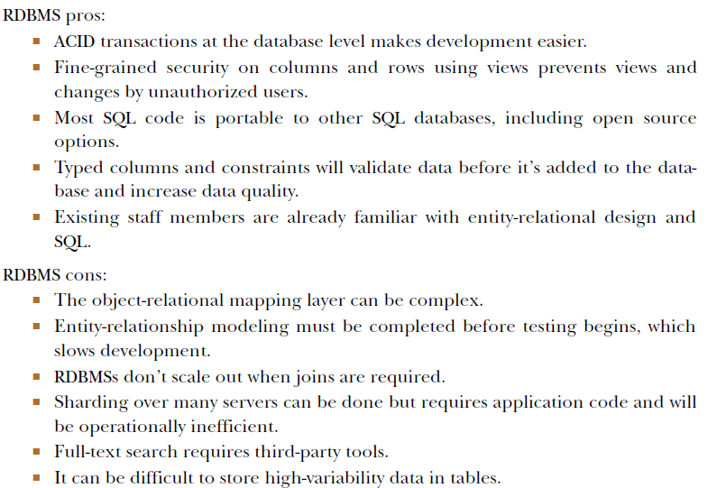

Slide 6
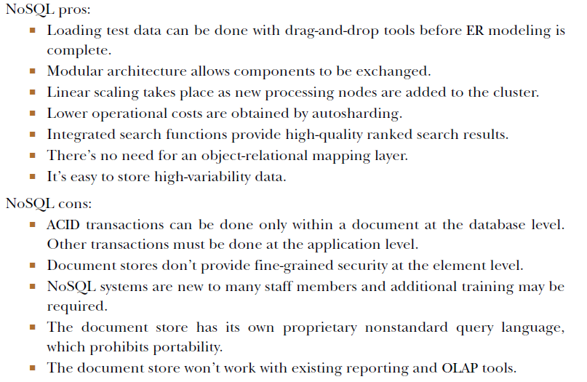

Slide 7
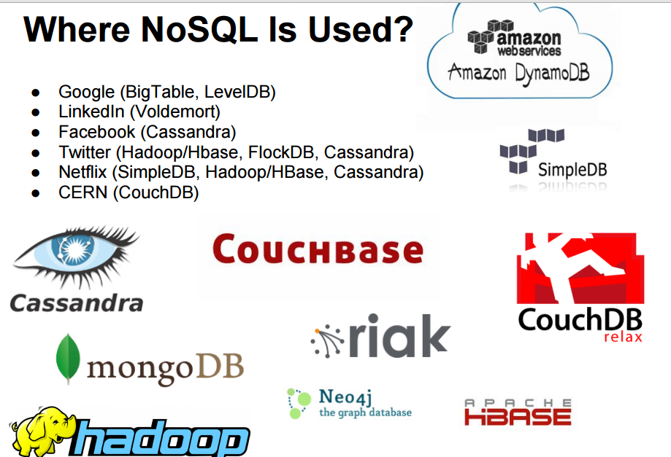

Slide 8
NOSQL BUSINESS DRIVERS
Because of NOSQL businesses have found value in rapidly capturing and analyzing large amounts of variable data, and making immediate changes in their businesses based on the information they receive.
The demands of volume, velocity, variability, and agility play a key role in the emergence of NoSQL solutions.
As each of these drivers applies pressure to the single-processor relational model, its foundation becomes less stable and in time no longer meets the organization’s needs.

Slide 9
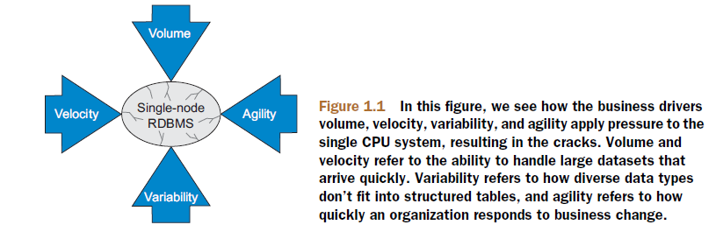

Slide 10
Volume
In traditional RDBMS there were servers with single processors such that the processing Speed was depends on Single chip processors
This phenomenon, known as the power wall, forced systems designers to shift their focus from increasing speed on a single chip to using more processors working together.
The need to scale out (also known as horizontal scaling), rather than scale up (faster processors), moved organizations from serial to parallel processing where data problems are split

Slide 11
Velocity
Though big data problems are a consideration for many organizations moving away from RDBMSs, the ability of a single processor system to rapidly read and write data is also key.
Many single-processor RDBMSs are unable to keep up with the demands of real-time inserts and online queries to the database made by public-facing websites. RDBMSs frequently index many columns of every new row, a process which decreases system performance.
When single-processor RDBMSs are used as a back end to a web store front, the random bursts in web traffic slow down response for everyone, and tuning these systems can be costly when both high read and write throughput is desired.

Slide 12
Variability
Companies that want to capture and report on exception data struggle when attempting to use rigid database schema structures imposed by RDBMSs.
For example, if a business unit wants to capture a few custom fields for a particular customer, all customer rows within the database need to store this information even though it doesn’t apply.
Adding new columns to an RDBMS requires the system be shut down and ALTER TABLE commands to be run. When a database is large, this process can impact system
availability, costing time and money.

Slide 13
Agility
The most complex part of building applications using RDBMSs is the process of putting data into and getting data out of the database.
If your data has nested and repeated subgroups of data structures, you need to include an object-relational mapping layer.
The responsibility of this layer is to generate the correct combination of INSERT, UPDATE, DELETE, and SELECT SQL statements to move object data to and from the RDBMS persistence layer.
This process isn’t simple and is associated with the largest barrier to rapid change when developing new or modifying existing applications , which is called Agility

Slide 14
Case Studies
Case study 1: LiveJournal’s Memcache
The engineers at LiveJournal created a simple way to create a distinct “signature” of every SQL query.
This signature or hash was a short string that represented a SQL SELECT statement. By sending a small message between web servers, any web server could ask the other servers if they had a copy of the SQL result already executed.
If one did, it would return the results of the query and avoid an expensive round trip to the already overwhelmed SQL database. They called their system Memcache because it managed RAM memory cache.

Slide 15
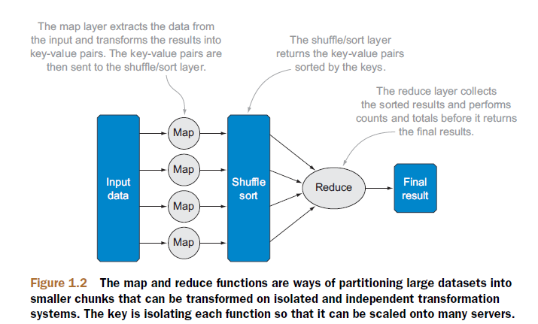
Case Studies
Case study 2: Google’s MapReduce—use commodity hardware to create search indexes
It was Google’s use of MapReduce that encouraged others to take another look at the power of functional programming and the ability of functional programming systems to scale over thousands of low-cost CPUs. Software packages such as Hadoop have closely modeled these functions.

Slide 16
Case Studies
Case study 3: Google’s Bigtable—a table with a billion rows and a million columns
The motivation behind Bigtable was the need to store results from the web crawlers that extract HTML pages, images, sounds, videos, and other media from the internet.
The resulting dataset was so large that it couldn’t fit into a single relational database, so Google built their own storage system.
Their fundamental goal was to build a system that would easily scale as their data increased without forcing them to purchase expensive hardware.
The solution was neither a full relational database nor a file system, but what they called a “distributed storage system” that worked with structured data.

Slide 17
Case Studies
Case study 4: Amazon’s Dynamo—accept an order 24 hours a day, 7 days a week
Amazon used a relational database to support its shopping cart and checkout system. They had unlimited licenses for RDBMS software and a consulting budget that allowed them to attract the best and brightest consultants for their projects
Amazon found that because key value stores had a simple interface, it was easier to replicate the data and more reliable.
At the end, Amazon used a key-value store to build a turnkey system that was reliable, extensible, and able to support their 24/7 business model, making them one of the most successful online retailers in the world.

Slide 18
Case Studies
Case study 5:MarkLogic
MarkLogic is a company that focused on managing large collections of XML documents. Because XML documents contained markup, they named the company MarkLogic.
MarkLogic defined two types of nodes in a cluster: query and document nodes.
Query nodes receive query requests and coordinate all activities associated with executing a query.
Document nodes contain XML documents and are responsible for executing queries on the documents in the local filesystem.
The MarkLogic architecture, moving queries to documents rather than moving documents to the query server, allowed them to achieve linear scalability with petabytes of documents.
MarkLogic found a demand for their products in US federal government systems that stored terabytes of intelligence information and large publishing entities that wanted to store and search their XML documents.

Slide 19
NoSQL data architecture patterns or TYPES OF NO-SQL
There are 4 basic types of NoSQL databases:
Key-Value Store – It has a Big Hash Table of keys & values {Example- Riak, Amazon S3 (Dynamo)}
Graph-based-A network database that uses edges and nodes to represent and store data. {Example- Neo4J}
Document-based Store- It stores documents made up of tagged elements. {Example- CouchDB,MongoDB}
Column-based Store- Each storage block contains data from only one column, {Example- HBase, Cassandra,Bigtables}

Slide 20
key-value store
A key-value store is a simple database that when presented with a simple string (the key) returns an arbitrary large BLOB of data (the value). Key-value stores have no query language; they provide a way to add and remove key-value pairs into/from a database.
A key-value store is like a dictionary. A dictionary has a list of words and each word has one or more definitions
The dictionary is a simple key-value store where word entries represent keys and definitions represent values.

Slide 21
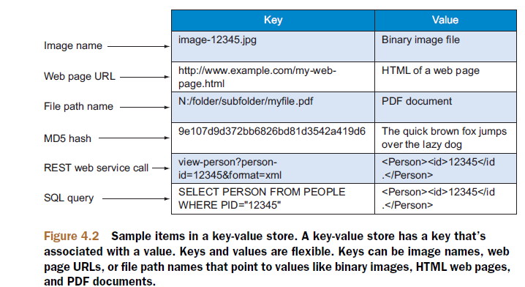

Slide 22
Key value
The key value type basically, uses a hash table in which there exists a unique key and a pointer to a particular item of data.
Key-Value is based on a hash table where there is a unique key and a pointer to a particular item of data.
Key | Value
“India” | {“B-25, Sector-58, Noida, India – 201301″
“Romania” | {“IMPS Moara Business Center, Buftea No. 1, Cluj-Napoca, 400606″,City Business Center, Coriolan Brediceanu No. 10, Building B, Timisoara, 300011″}
“US” | {“3975 Fair Ridge Drive. Suite 200 South, Fairfax, VA 22033″}

Slide 23
Key value
This key/value type database allow clients to read and write values using a key as follows:
Get(key), returns the value associated with the provided key.
Put(key, value), associates the value with the key.
Multi-get(key1, key2, .., keyN), returns the list of values associated with the list of keys.
Delete(key), removes the entry for the key from the data store.

Slide 24
Operations
key-value store uses put, get, and delete functions, as shown here:
put($key as xs:string, $value as item()) adds a new key-value pair to the table and will update a value if this key is already present.
get($key as xs:string) as item() returns the value for any given key, or it may return an error message if there’s no key in the key-value store.
delete($key as xs:string) removes a key and its value from the table, or it many return an error message if there’s no key in the key-value store.

Slide 25
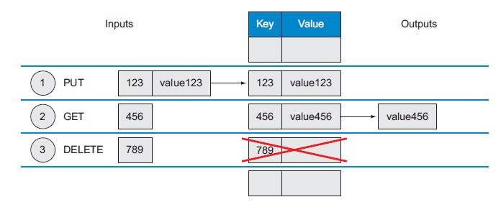

Slide 26
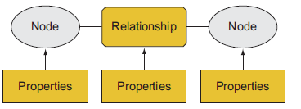
Graph stores
Graph stores are highly optimized to efficiently store graph nodes and links, and allow you to query these graphs.
Graph databases are useful for any business problem that has complex relationships between objects such as social networking, rules-based engines, creating mashups, and graph systems that can quickly analyze complex network structures and find patterns within these structures.
A graph store has three data fields: nodes, relationships, and properties. Some types of graph stores are referred to as triple stores because of their node-relationship-node structure

Slide 27
Graph stores
Graph queries are similar to traversing nodes in a graph. You can query to ask things like these:
○ What’s the shortest path between two nodes in a graph?
○ What nodes have neighboring nodes that have specific properties?
○ Given any two nodes in a graph, how similar are their neighboring nodes?
○ What’s the average connectedness of various points on a graph with each other?

Slide 28
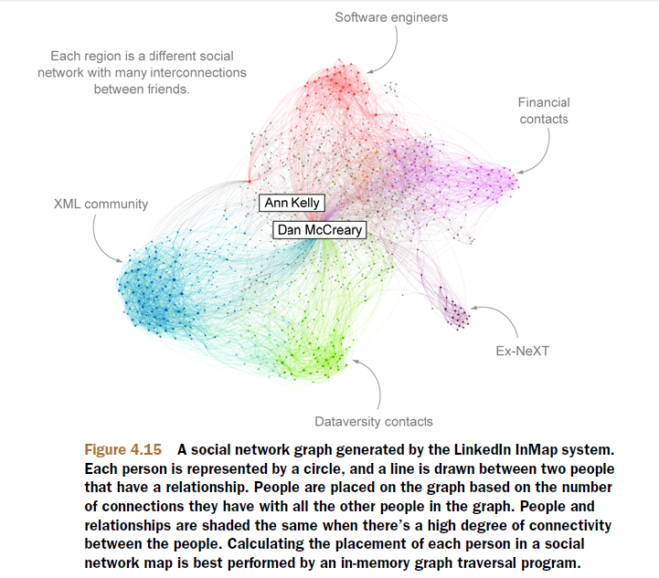

Slide 29
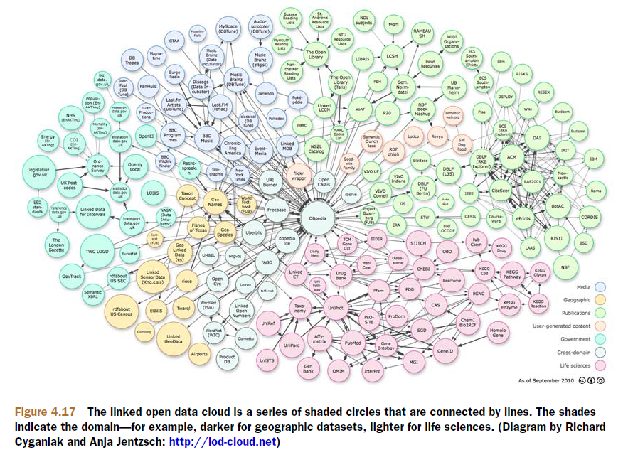

Slide 30
Graph stores
Graph stores are used for things beyond social networking—they’re appropriate for identifying distinct patterns of connections between nodes.
For example,
Creating a graph of all incoming and outgoing phone calls between people in a prison might show a concentration of calls (patterns) associated with organized crime.
Analyzing the movement of funds between bank accounts might show patterns of money laundering or credit card fraud. Companies that are under criminal investigation might have all of their email messages analyzed using graph software to see who sent who what information and when.
Law firms, law enforcement agencies, intelligence agencies, and banks are the most frequent users of graph store systems to detect legitimate activities as well as for fraud detection.

Slide 31
Graph Databases
Graph databases focus on the relationships between the data, which is why graph data is often referred to as “linked data.”
Data points are called nodes, and the relationship between one data point and another is called an edge.
These relationships make graph databases ideal for social media sites such as LinkedIn, Facebook, and Twitter where questions are asked about “degrees of separation” between people.

Slide 32
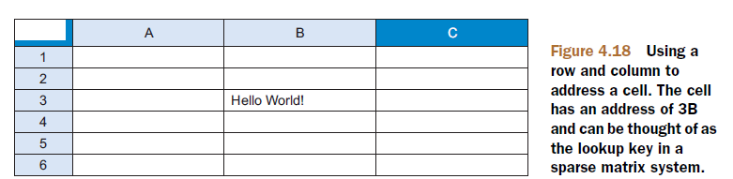
Column family stores
Column family systems are important NoSQL data architecture patterns because they can scale to manage large volumes of data. They’re also known to be closely tied with many MapReduce systems.
Column family stores use row and column identifiers as general purposes keys for data lookup. They’re sometimes referred to as data stores rather than databases.
Google Bigtable ,HBase, Hypertable, and Cassandra are good examples of this systems

Slide 33
Column family stores
The column family approach of using a row ID and column name as a lookup key is a flexible way to store data, gives you benefits of higher scalability and availability, and saves you time and hassles when adding new data to your system.
A column store database stores all information within a column of a table at the same location on disk in the same way a row-store keeps row data together.
column family systems don’t rely on joins, they tend to scale well on distributed systems.
it has higher scalability, higher availability and provide easy way to add new data

Slide 34
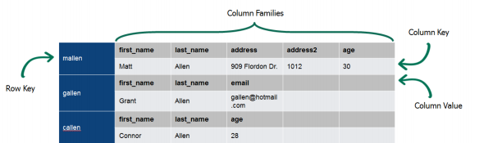
Column Family Stores
Store and process very large amounts of data distributed over many machines.

Slide 35
Document stores
In document store each record it considered as a separate document
A document store is everything inside a document is automatically indexed when a new document is added. Though the indexes are large, everything is searchable.
Most document stores group documents together in collections.
Each document store has an API or query language that specifies the path or path expression to any node or group of nodes.

Slide 36
Document Store No SQL Database
The data which is a collection of key value pairs is compressed as a document store quite similar to a key-value store, but the only difference is that the values stored (referred to as “documents”) provide some structure and encoding of the managed data. XML, JSON (Java Script Object Notation), BSON (which is a binary encoding of JSON objects) are some common standard encodings.

Slide 37
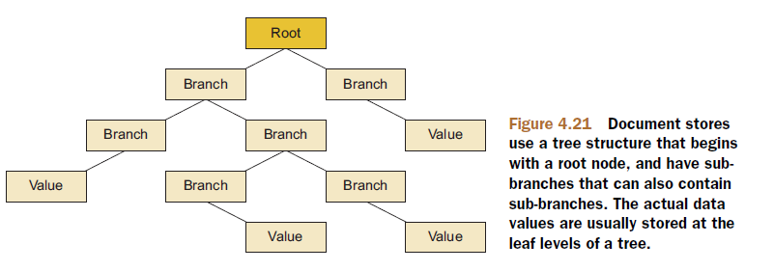

Slide 38
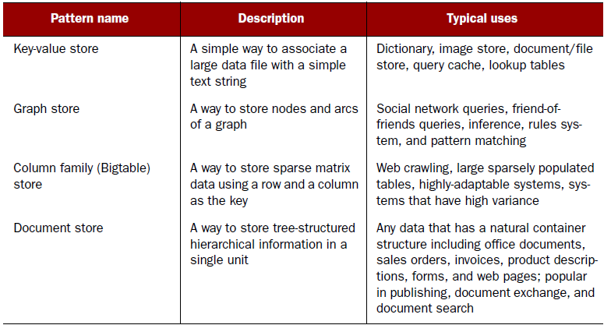

Slide 39
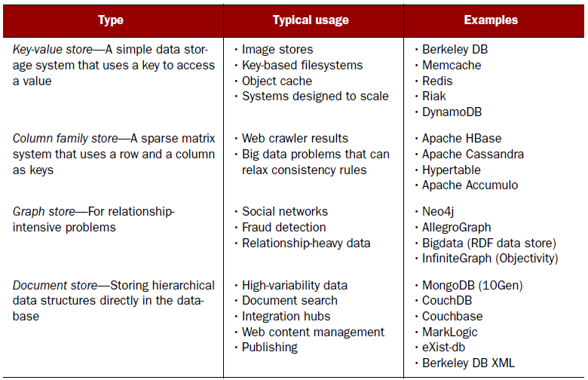

Slide 40

MongoDB is a cross-platform, document oriented database that provides, high performance, high availability, and easy scalability. MongoDB works on concept of collection and document.
Database is a physical container for collections. Each database gets its own set of files on the file system. A single MongoDB server typically has multiple databases.

Slide 41
Collection is a group of MongoDB documents.
It is the equivalent of an RDBMS table.
Collections do not enforce a schema.
Documents within a collection can have different fields. Typically, all documents in a collection are of similar or related purpose.

Slide 42
A document is a set of key-value pairs. Documents have dynamic schema. Dynamic schema means that documents in the same collection do not need to have the same set of fields or structure, and common fields in a collection's documents may hold different types of data.

Slide 43
RDBMS | MongoDB
Database | Database
Table | Collection
Tuple/Row | Document
column | Field
Primary Key | Primary Key (Default key _id provided by mongodb itself)

Slide 44
MongoDB supports many data types whose list is given below:
String
Integer
Boolean
Double
Min/ Max keys
Arrays
Timestamp
Object
Null :
Symbol :
Date :
Binary data

Slide 45
The use Command in MongoDB is used to create database.
use DATABASE_NAME
>use mydb
switched to db mydb
To check your currently selected database use the command db
>db mydb
If you want to check your databases list, then use the command show dbs.
>show dbs local 0.78125GB test 0.23012GB

Slide 46
Delete Database
db.dropDatabase()
Create Collection
db.createCollection(name, options)
>db.createCollection("mycollection")
{ "ok" : 1 }
>show collections mycollection system.indexes

Slide 47
Insert Records
>db.movie.insert({"name":"tutorials point"})
>show dbs
local 0.78125GB
mydb 0.23012GB
test 0.23012GB

Slide 48
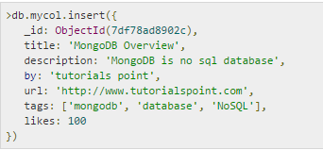
_id is 12 bytes hexadecimal number unique for every document in a collection.

Slide 49
To insert multiple documents in single query, you can pass an array of documents in insert() command.

Slide 50
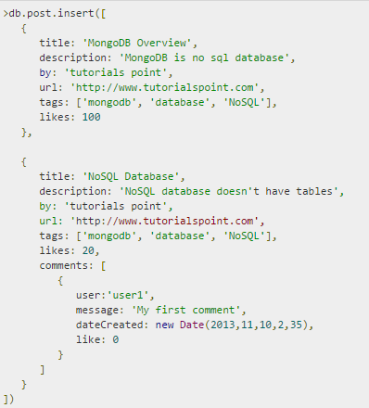

Slide 51
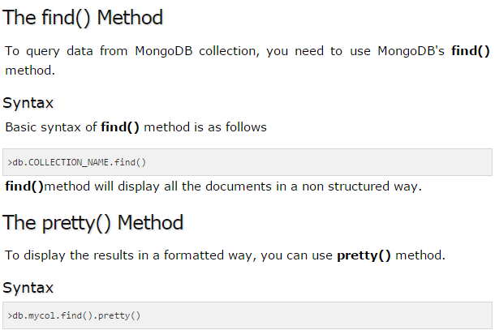

Slide 52
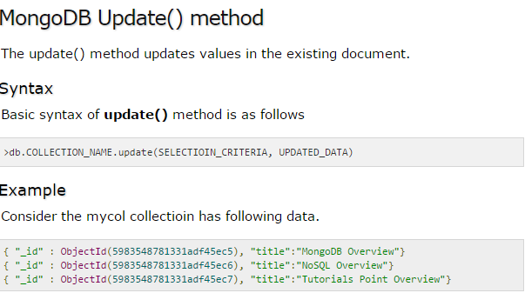
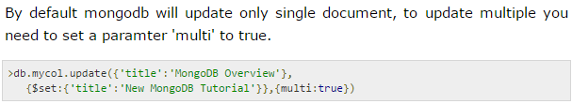

Slide 53

The save() method replaces the existing document with the new document passed in save() method
Syntax
>db.COLLECTION_NAME.save({_id:ObjectId(),NEW_DATA})
The remove() Method is used to remove document from the collection. remove() method accepts two parameters. One is deletion criteria and second

Slide 54
Thank You

